Slide 1

Improving Length of Stay Prediction
Using a Hidden Markov Model
S04
Machine Learning in Clinical Predictive Modeling I
Presenter : Mani Sotoodeh
Institution : Department of Computer Science - Emory University
Twitter: @Manis29467226
#IS19

Slide 2

Importance of Length of Stay Prediction
Physician correctly predict short or long staying patients only 50% of time
Intervention to prevent adverse outcomes in patients
Optimization of resource allocation (Equipment and Beds)
Allocation of staff and care to high risk patients
Improving overall patients' satisfaction and hospitals’ reputation
Class | < 48 Houres | 2-5 days | > 5 days
Accuracy | 53.1 % | 59.8 % | 31.1 %
Adapted with changes from : Nassar Jr AP, Caruso P. ICU physicians are unable to accurately predict length of stay at admission: a prospective study. International Journal for Quality in Health Care. 2015;28(1):99–103.

Slide 3

Motivation, The case for HMM
Most of the previous work is on classification rather than regression
More accurate prediction, increasing precision where its needed the most
Track multiple physiologic measurements and their interactions over time
Evolution of Latent variables through time may capture the aggregate trend
States can be interpretable by physicians
Possibly indicating severity or progress of patients’ underlying disease symptoms

Slide 4
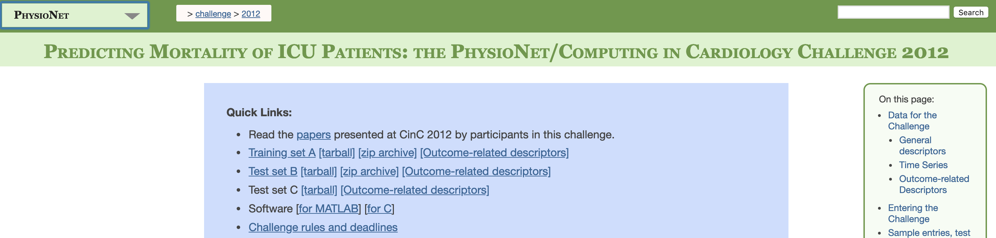
Dataset : Physionet2012
Physionet 2012 Challenge
General demographics including age and gender + 37 different physiological measurements of 4000 patients for the first 48 hours after their ICU admission
Publicly available without any paperwork and thus easily reproducible by others
More studies available for comparison
The size of dataset while sufficient for learning is also realistic for practical purpose, i.e. a single hospital
https://physionet.org/challenge/2012/

Slide 5
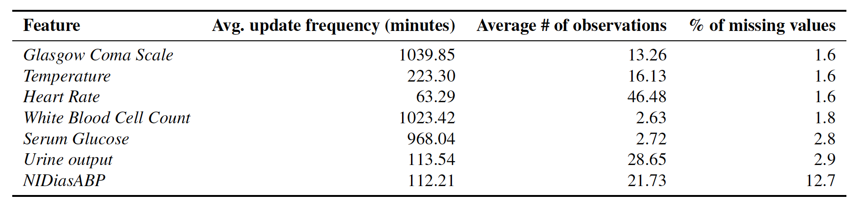
Problem Statement
Regression task
Input : Physiological Measurements throughout time for 48 hours
Blood pressure
Temperature
Heart rate
Glasgow Coma Score
Serum Glucose,
White Blood Cell Count
Urine Output.
Output : Length of stay in ICU in days

Slide 6
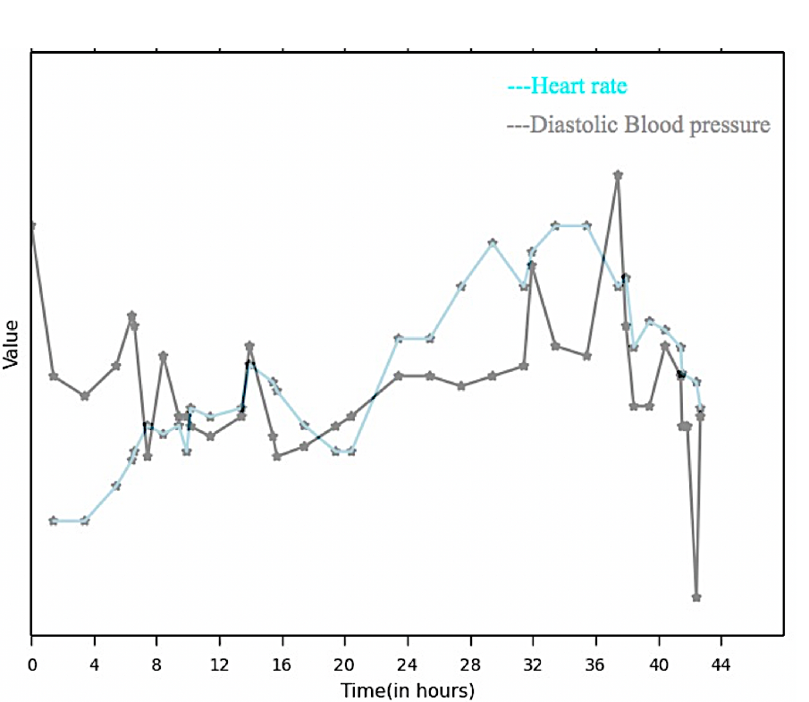
Baseline Models
Minimum, Maximum, Average, First and Last in time (5 statistics) for each of the 7 variables
35 features in total for each patient
Five common regression models: LASSO regression
Ridge regression
Poisson regression
Binomial regression
Support vector regression (SVR)
Annotated example for a given patient and two physiological measurement
BP maximum
BP First
HR maximum
HR Average
HR Last
BP Last
BP Average
HR minimum
HR First
BP minimum
Meanwhile HMM Model attempts to utilize all temporal information by considering all values

Slide 7
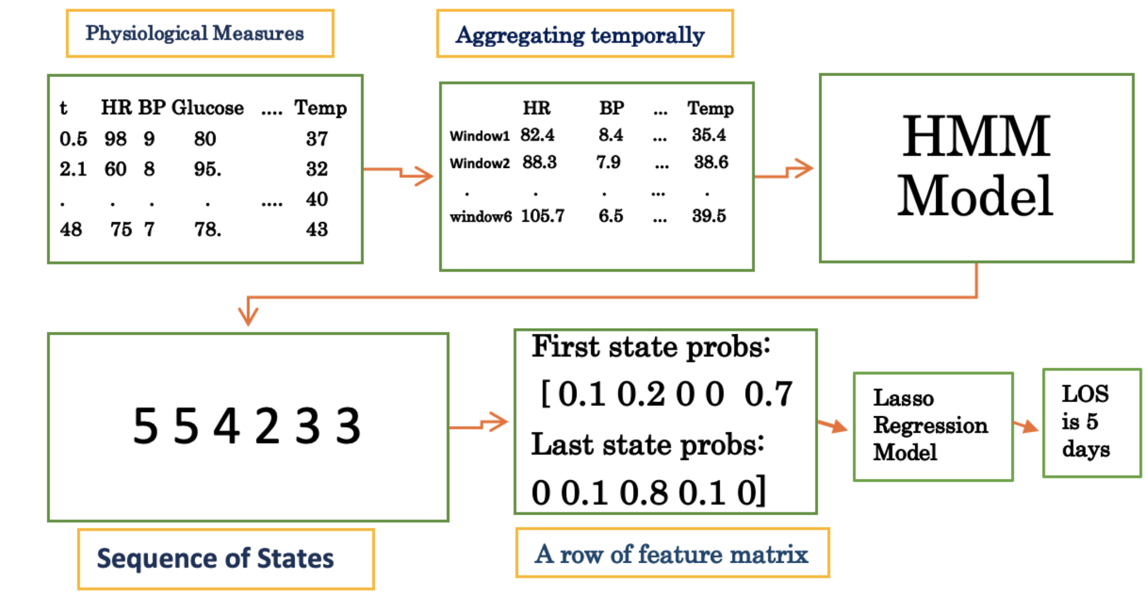
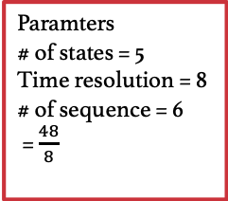
HMM Model Big Picture
Physionet 2012 data after imputation
Average, median or last time point value
Observations for a multi-feature Gaussian model
Spits out likelihood of each state for a given time window
Paramters
# of states = 5
Time resolution = 8
# of sequence = 6
= $\frac{48}{8}$
Most likely sequence of states
Len(Sequence) = # time windows
First and last worked the best among all combinations + small number of features

Slide 8
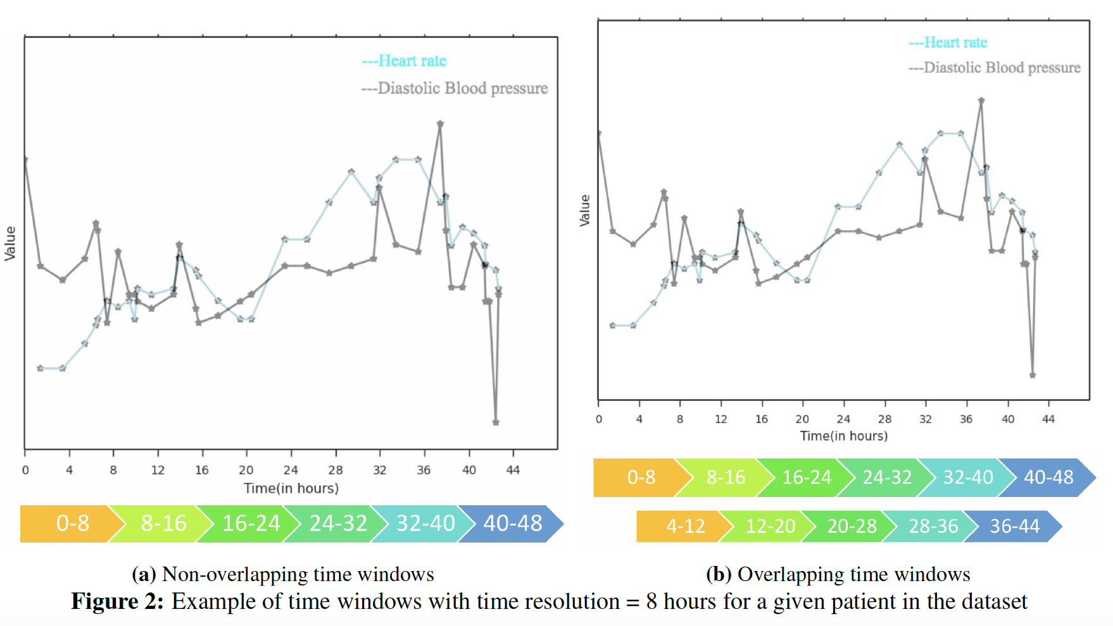
Visualization of Data for a single patient

Slide 9
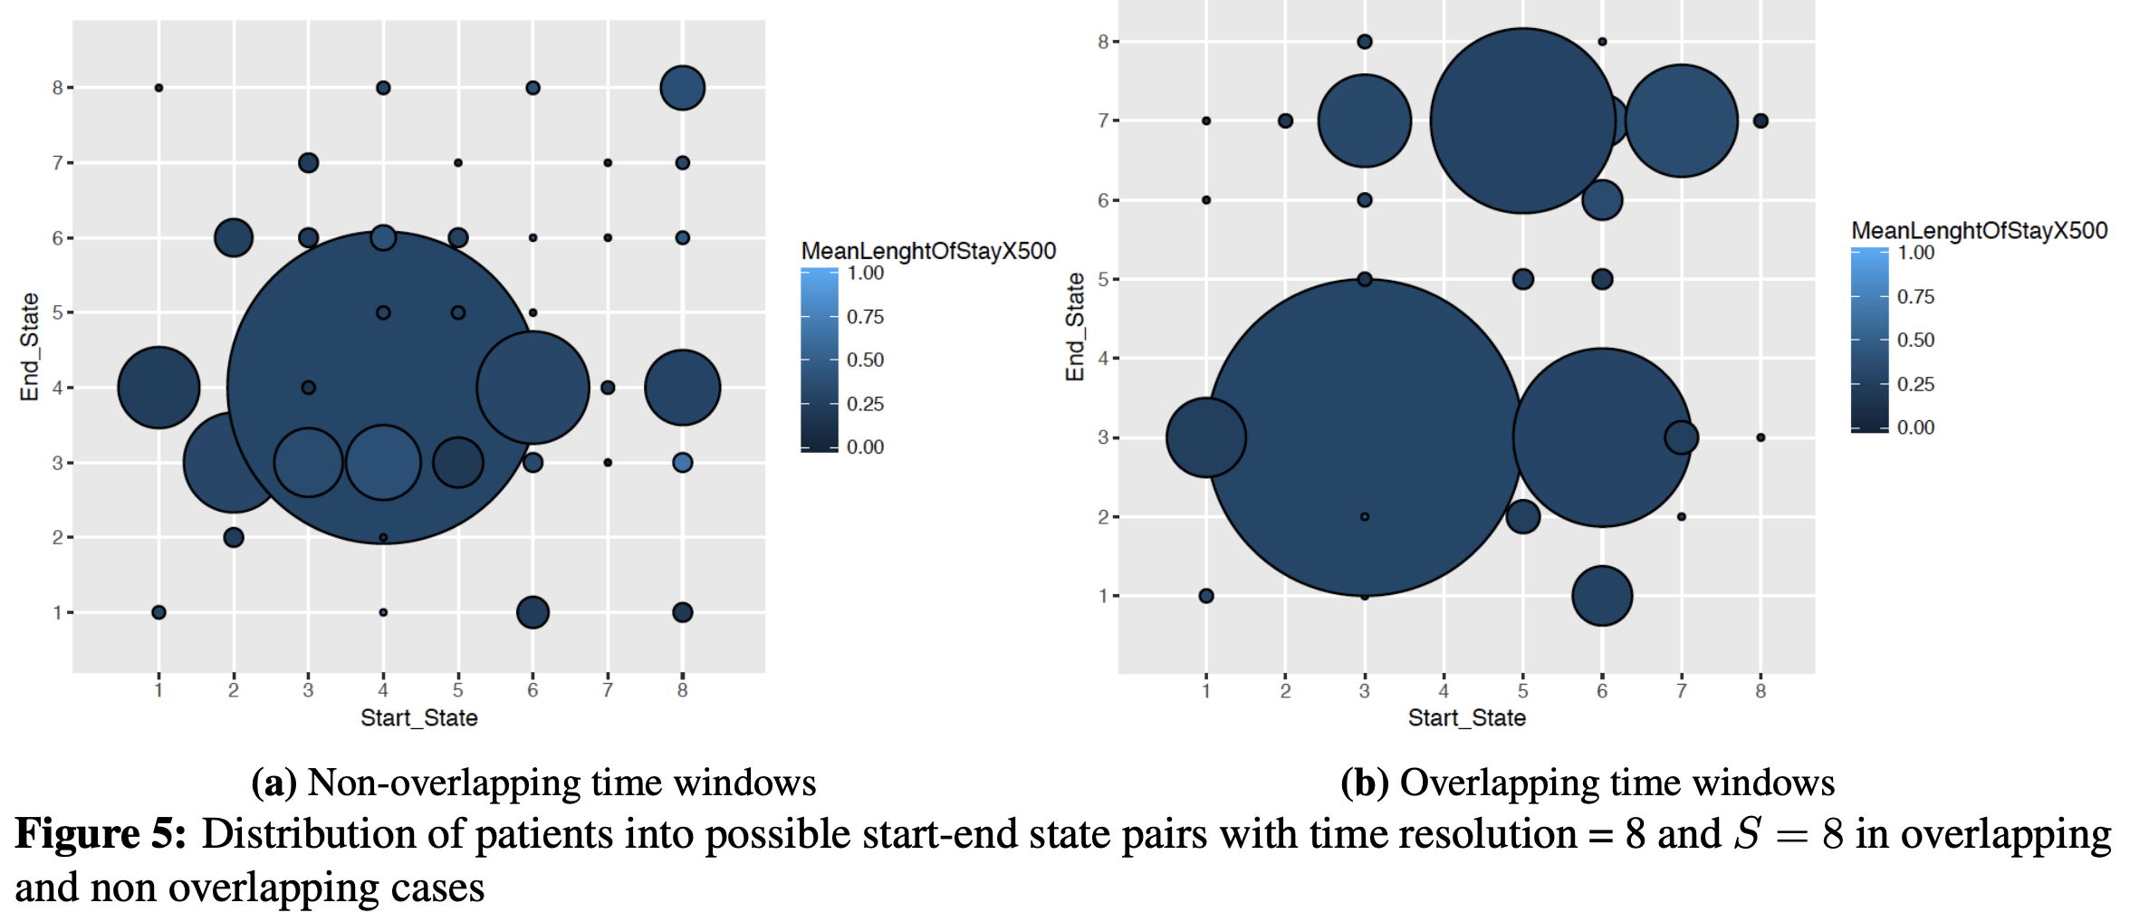
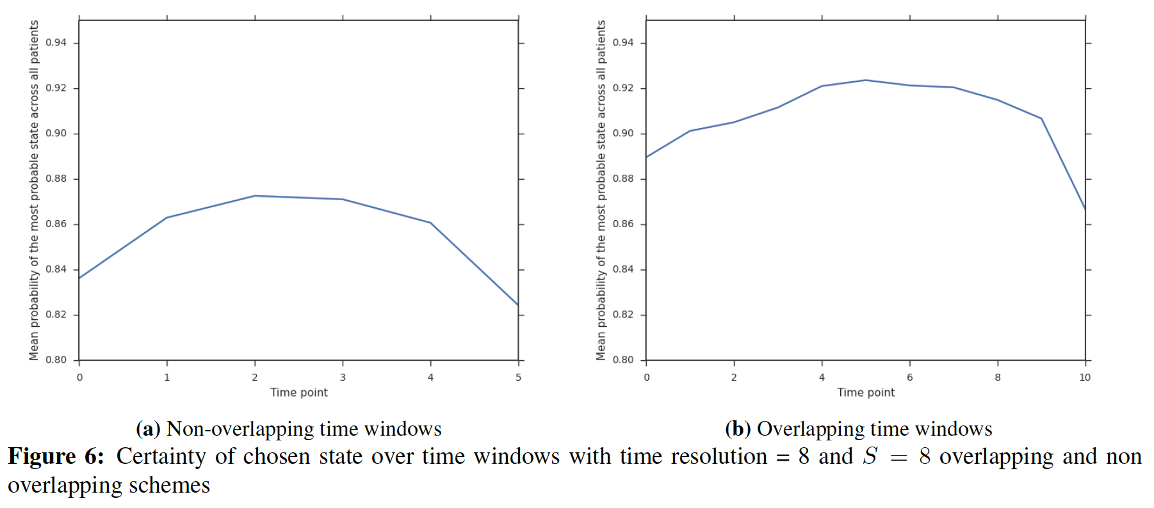
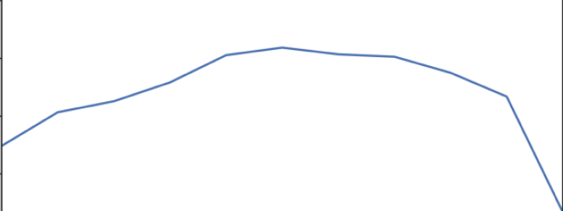
Design choices-Non/Overlapping time windows
Overlapping time windows
Non overlapping time windows
Time frame index
Certainty of inferred state at each time window, averaged for all patients
Notes:
Well distributed

Slide 10
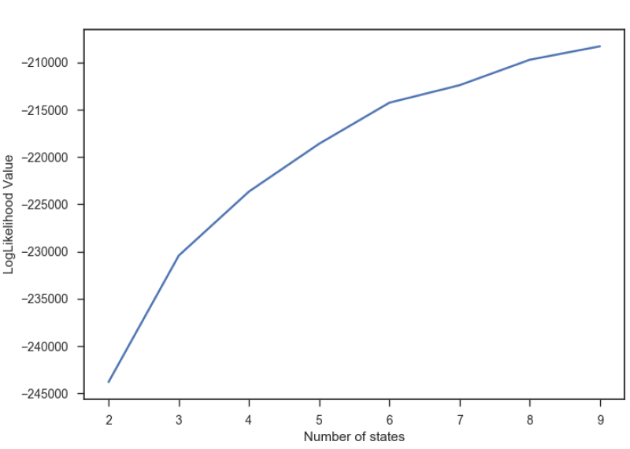
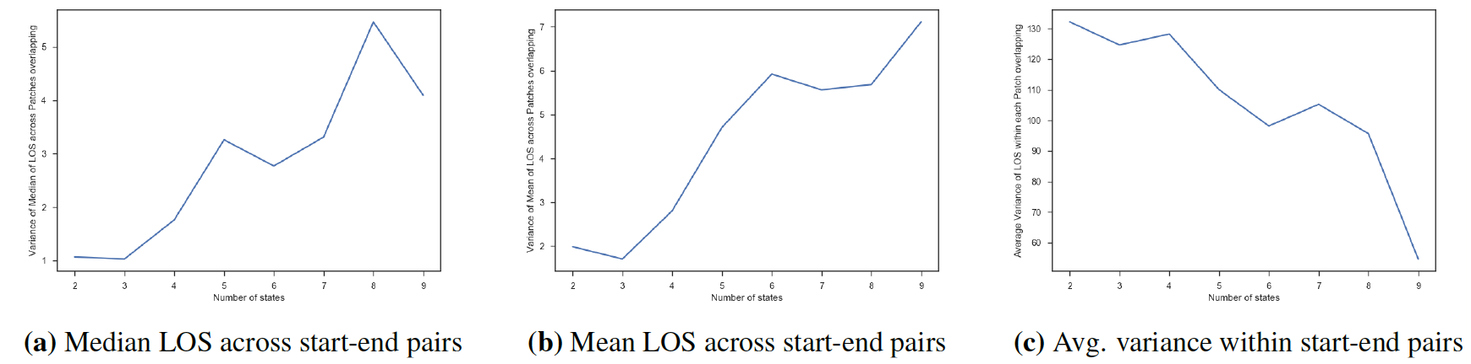
Design choices - Optimum # of states
Number of states = 8
Variance of Median LOS of Patients belonging to one start-end pair across all such pairs
Number of states = 8
Number of states = 8
Number of states
Number of states
Likelihood Value
Average of variance of LOS of Patients belonging to one start-end pair , averaged across all pairs
Number of states

Slide 11
RMSE Comparison
Model | RMSE ( In hours)
Lasso Regression | 234.19
Ridge Regression | 236.91
Poisson Regression | 235.26
Negative Binomial Regression | 235.01
Linear SVR | 237.99
RBF SVR | 236.97
HMM Method | 228.12
SAPS-II | 225.05

Slide 12
Combining ICU type
ICU Type | RMSE P-value w.r.t Baseline | RMSE mean of difference
1 Coronary Care | 0 | -1.97
2 Cardiac Surgery | 0 | -9.39
3 Medical | 0 | -7.56
4 Surgical | 0 | -6.07
ALL | 1 | 6.58
Combined (1,2) (3,4) | (0)(0) | (-9.48)(-9.96)
Combined (1,2,3) (4) | (0)(0.001) | (-12.44) (-4.66)
Combined (1,2,4) (3) | 0.1801 (0) | (-1.7) (-7.45)

Slide 13
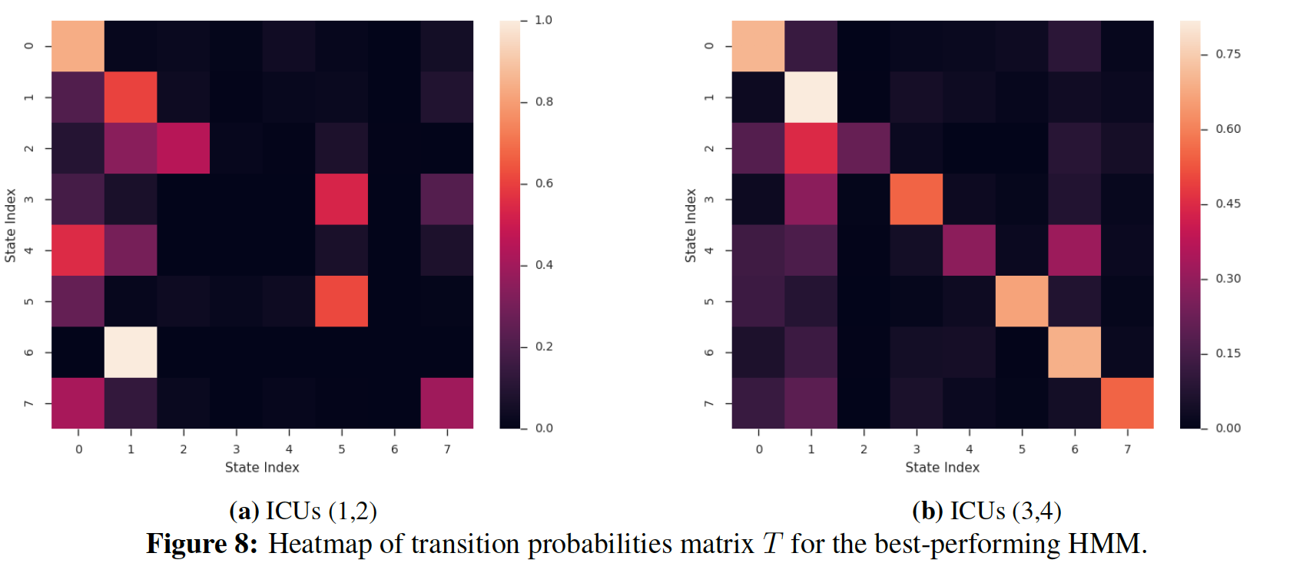
Interpretability

Slide 14
Thank you!
Email me at: msotood@emory.edu

Slide 15
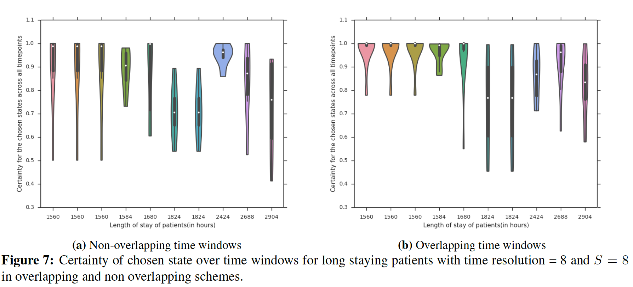
Design choices-Non/Overlapping time windows-continued

Slide 16
Design choices-Non/Overlapping time windows- continued
Non overlapping time windows
Certainty of inferred state at each time window, averaged for all patients
Overlapping time windows
Time frame index

